Slide 1
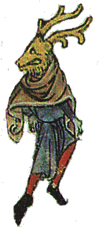
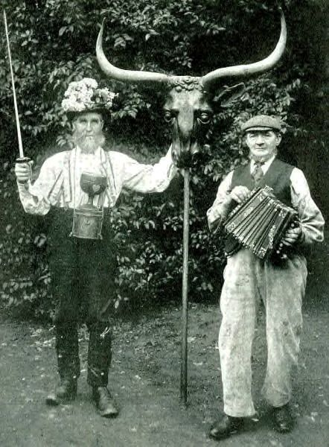
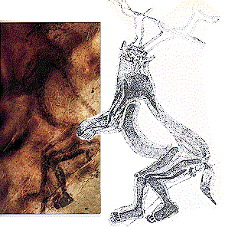
The Horned Lord
By A.C. Fisher Aldag

Slide 2
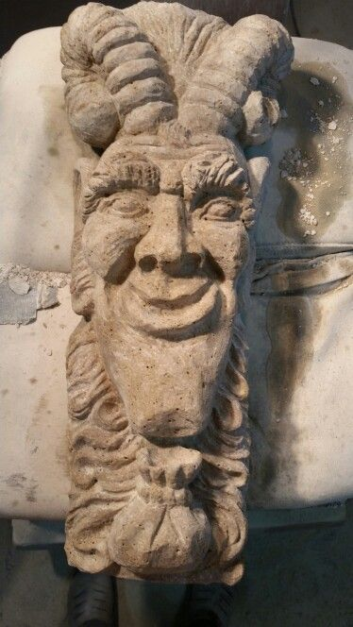
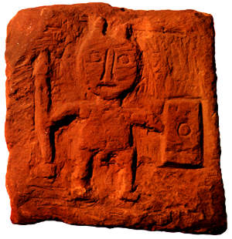
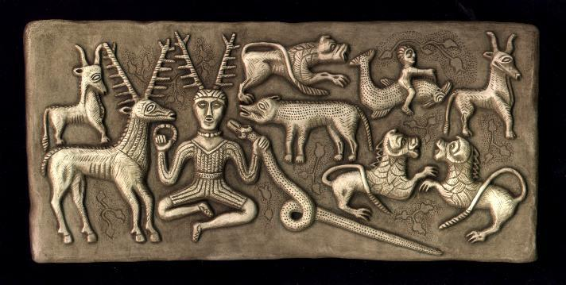
The Horned Lord by any other name…
Cernunnos
Cern = Horned;
Non or Nun = Deity
Karnayna
(Alex Sanders)
Atho
(Charles Cordell)
Ciarán or Keirnan
(Ireland)
Kernunno
(Gerald B. Gardner)
St. Cornelly
(Brittany)
Ol’ Horney
The Bucca / Buca
(Cornwall, Wales)
(Robert Cochrane)
Ol’ Crockhern
PAN
The Basajuan
(Basque)
Radien Kiedde
(Lapland)
Robin Goodfellow
Dis Pater
(Caesar)
PUCK

Slide 3
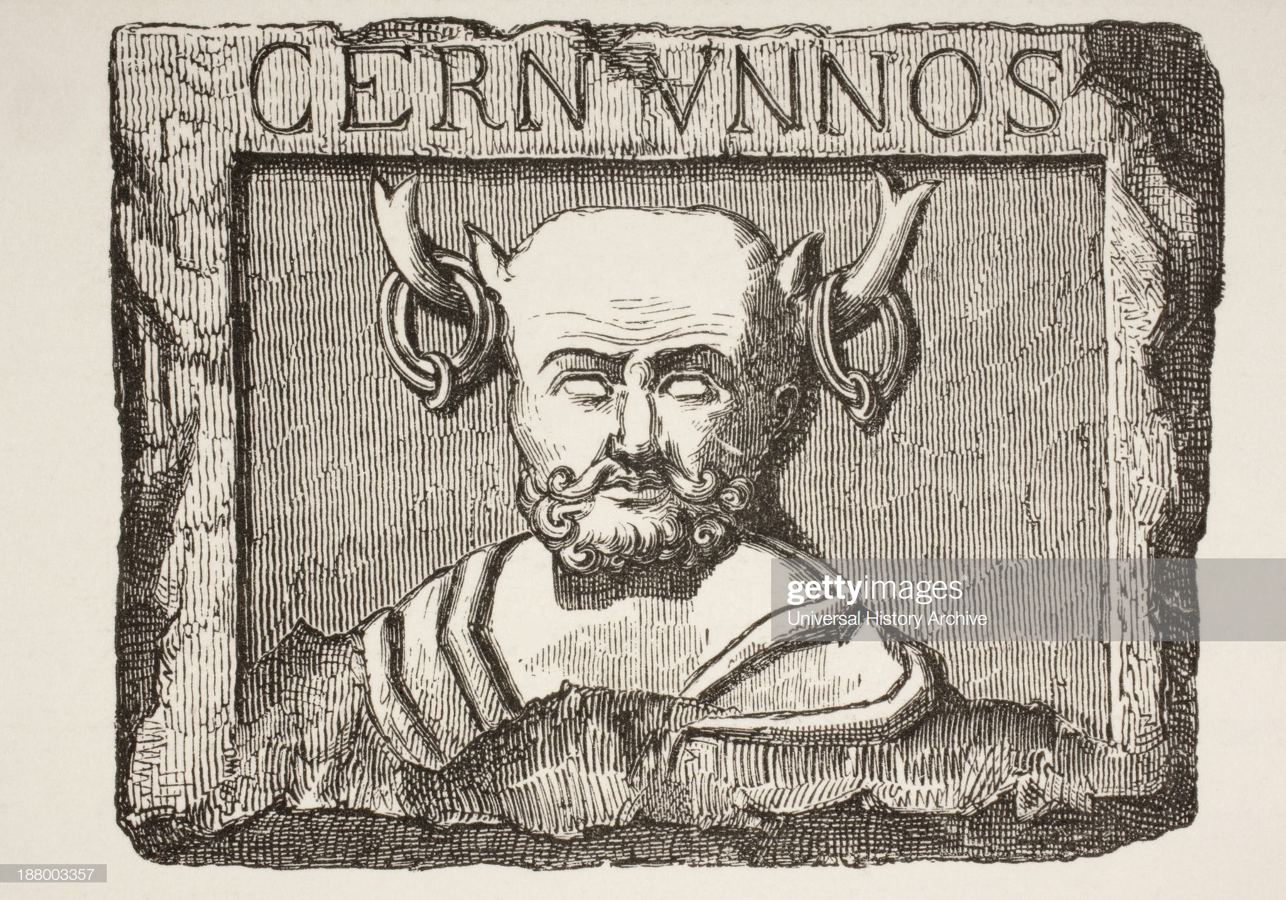
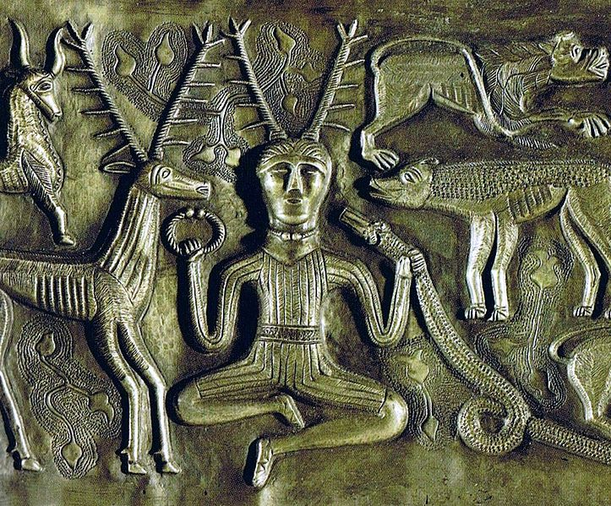
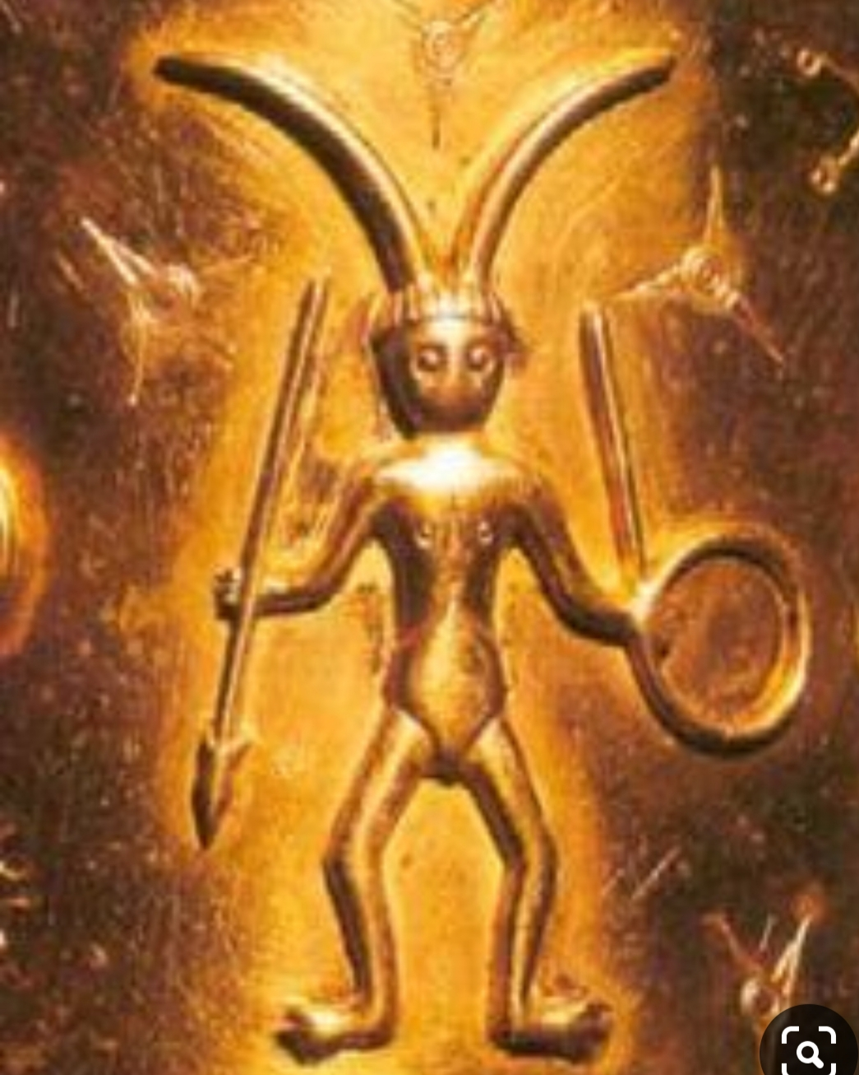
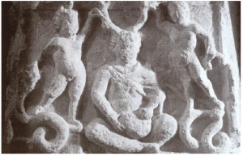
Cernunnos Criteria:
How can you tell if a figure represents The Horned Lord?
(Pick any Three)
Is male
Has horns or antlers
Represents sexuality, fertility, prosperity, fatherly protection, death, hunting, animals, the woodlands, or the natural world
Is seated in the lotus position, or
Is standing with weapons associated with hunting
Has symbols of animals, particularly dogs, stags, deer, bulls, rats, and a horned snake
Has other symbols including a torc, bag of coins or nuts, a cornucopia, and / or a wheel
Is found in a location currently or formerly occupied by “Celtic” tribes

Slide 4
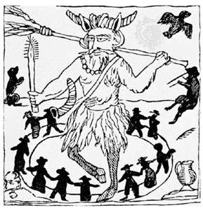
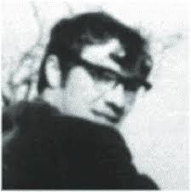
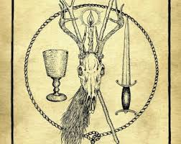
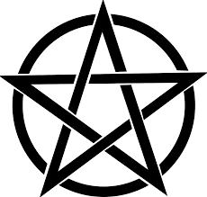
Modern Revivals:
Robert Cochrane
Gerald B. Gardner

Slide 5
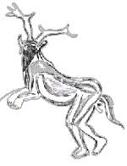
The Sorcerer
Upper Paleolithic / Mesolithic cave art in Cavern of Les Trois-Frères, in what is now Montesquieu-Avantès, in southwestern France

Slide 6
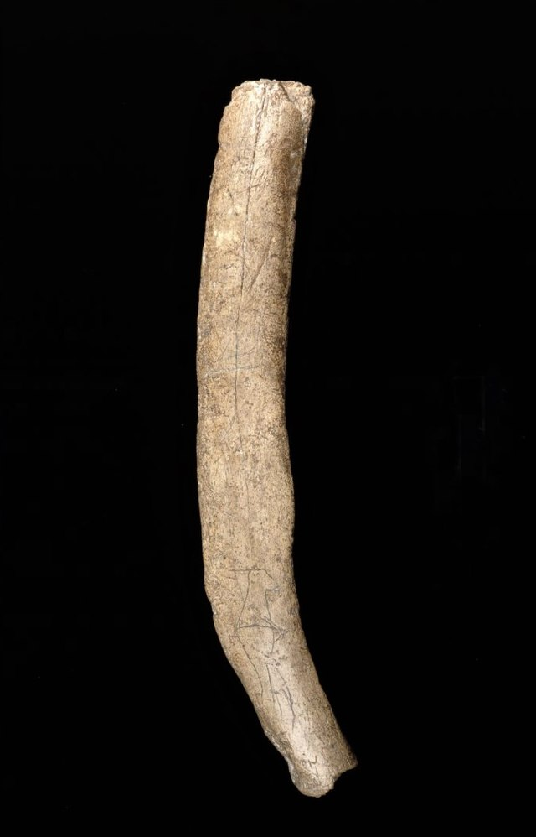
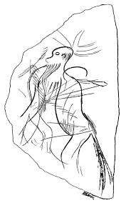
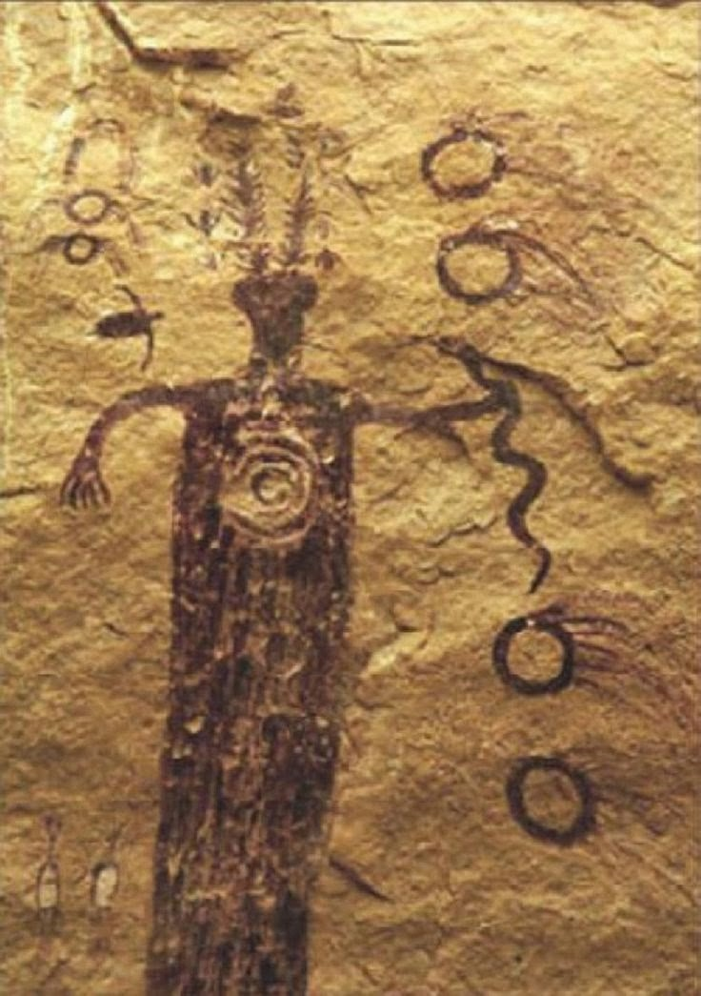
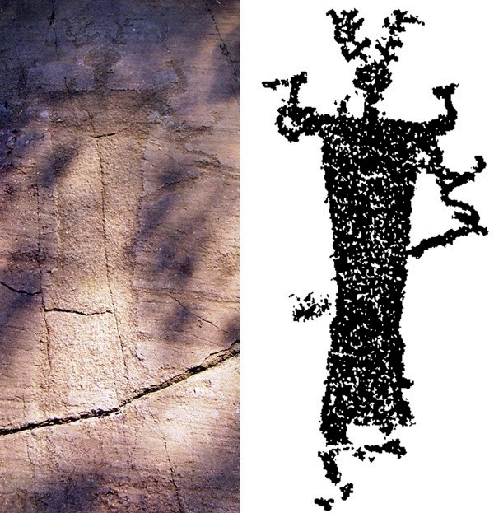
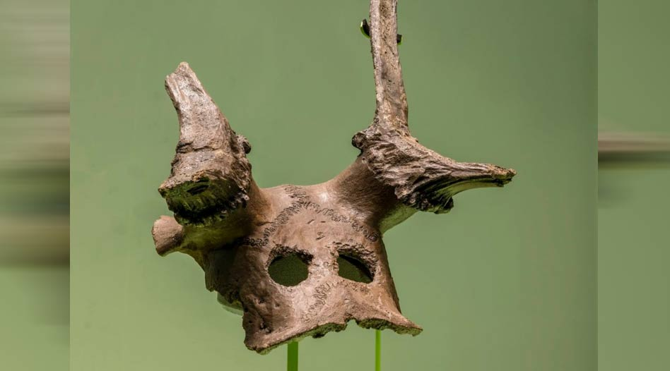
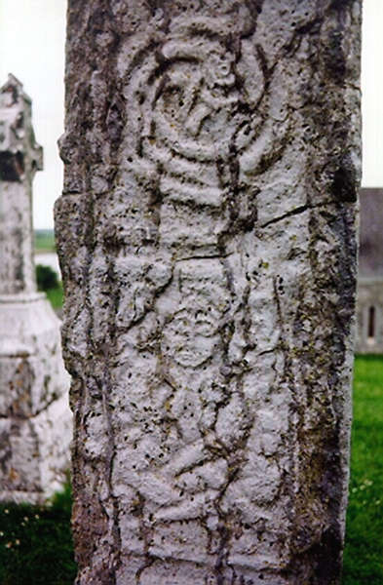
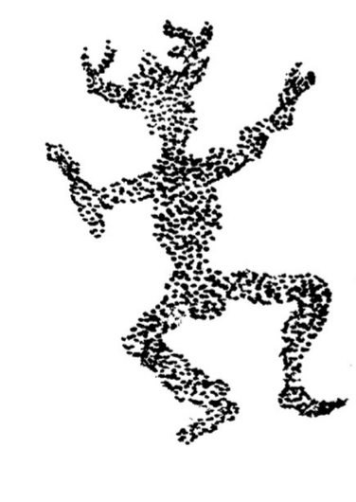
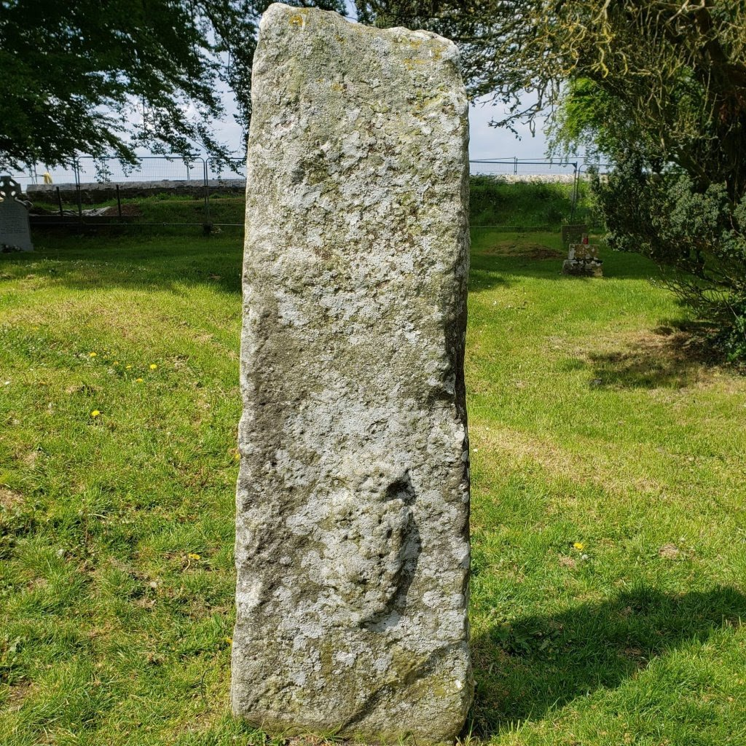
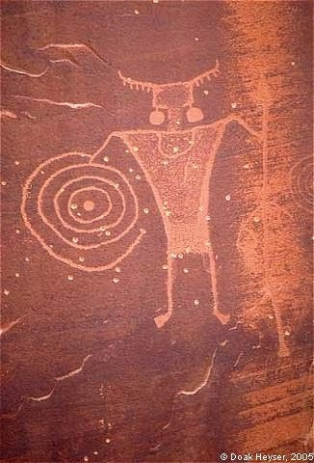
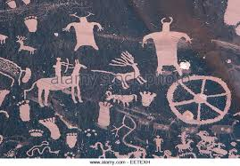
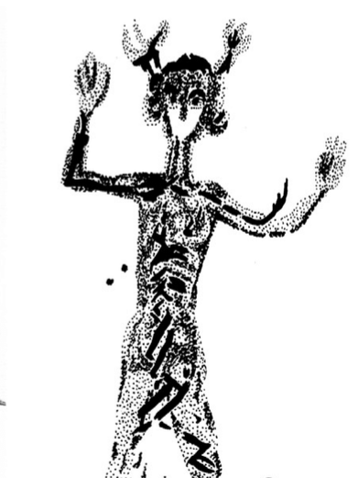
Other Mesolithic Horned Lord Images:
Britain
Britain
France
Italy
Spain
Utah, USA
Spain
Scotland
Ireland

Slide 7
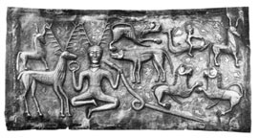
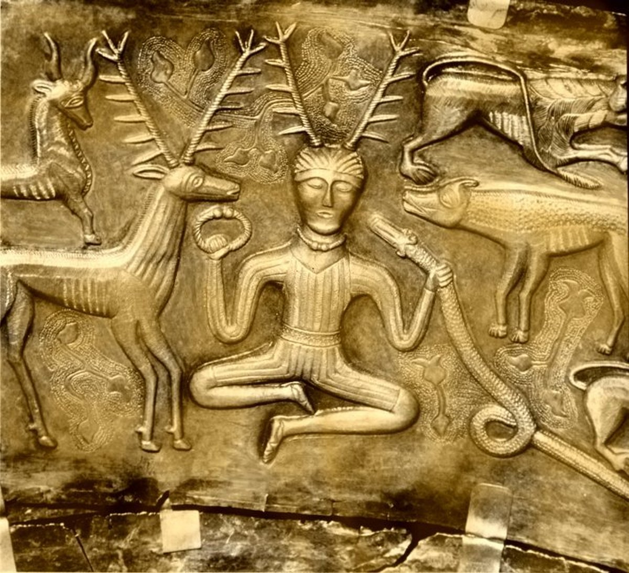
Gundestrop Cauldron
Most recognizable image of Cernunnos. Made of hammered silver. Found in Denmark (Jutland) in a bog, disassembled; possibly a votive offering. Celtic “LaTéne ” style, possibly crafted in Thrace, 150 to 50 B.C.E

Slide 8
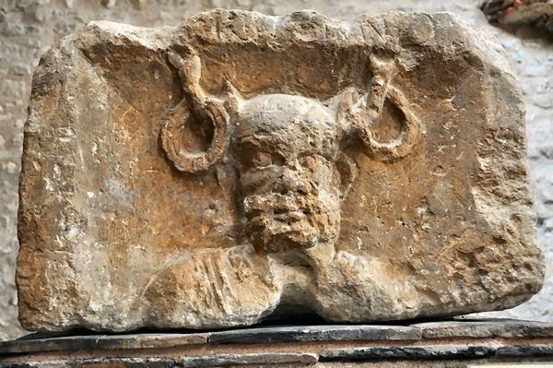
Pillar of the Boatmen
Found under Lutetia (which is now Paris) beneath Notre Dame Cathedral. Pre-200 C.E. One of 4 panels w/ Roman God images.
One of few w/ name “Cernunnos” !

Slide 9
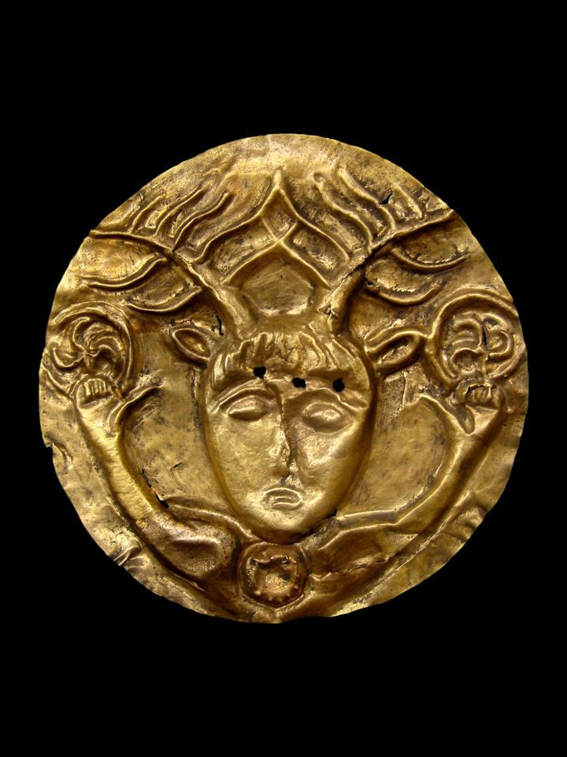
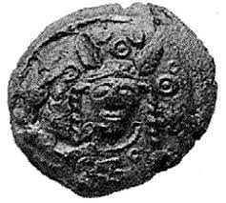
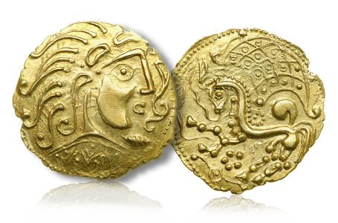
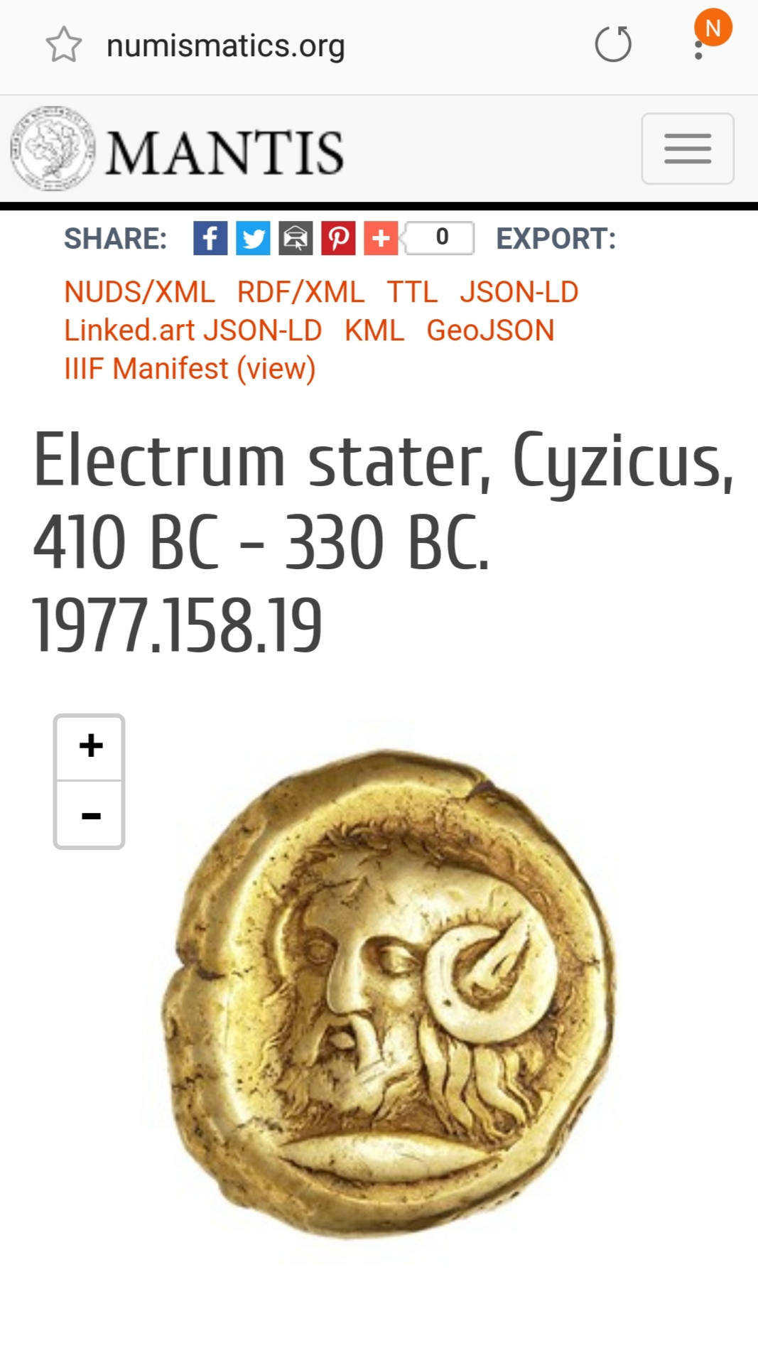
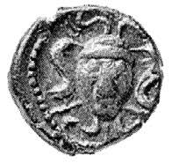
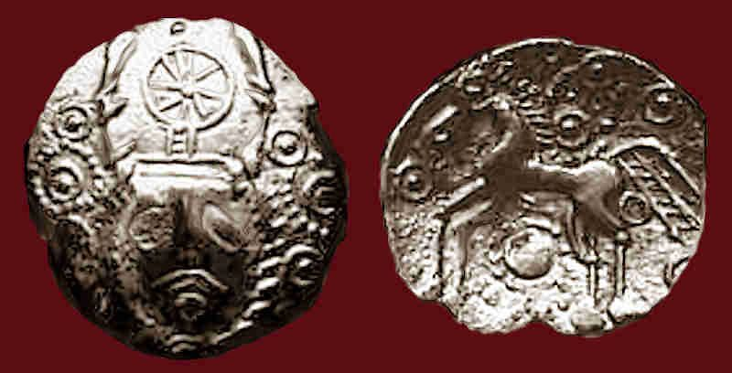
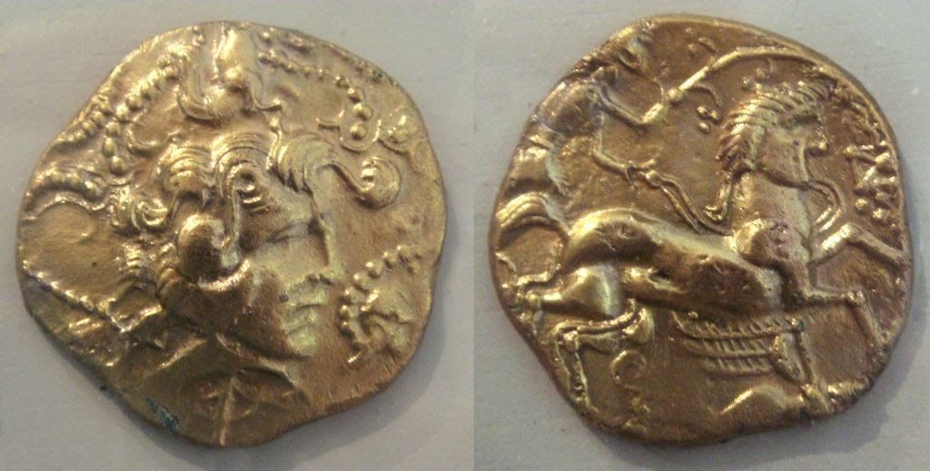
Cernunnos COINS

Slide 10
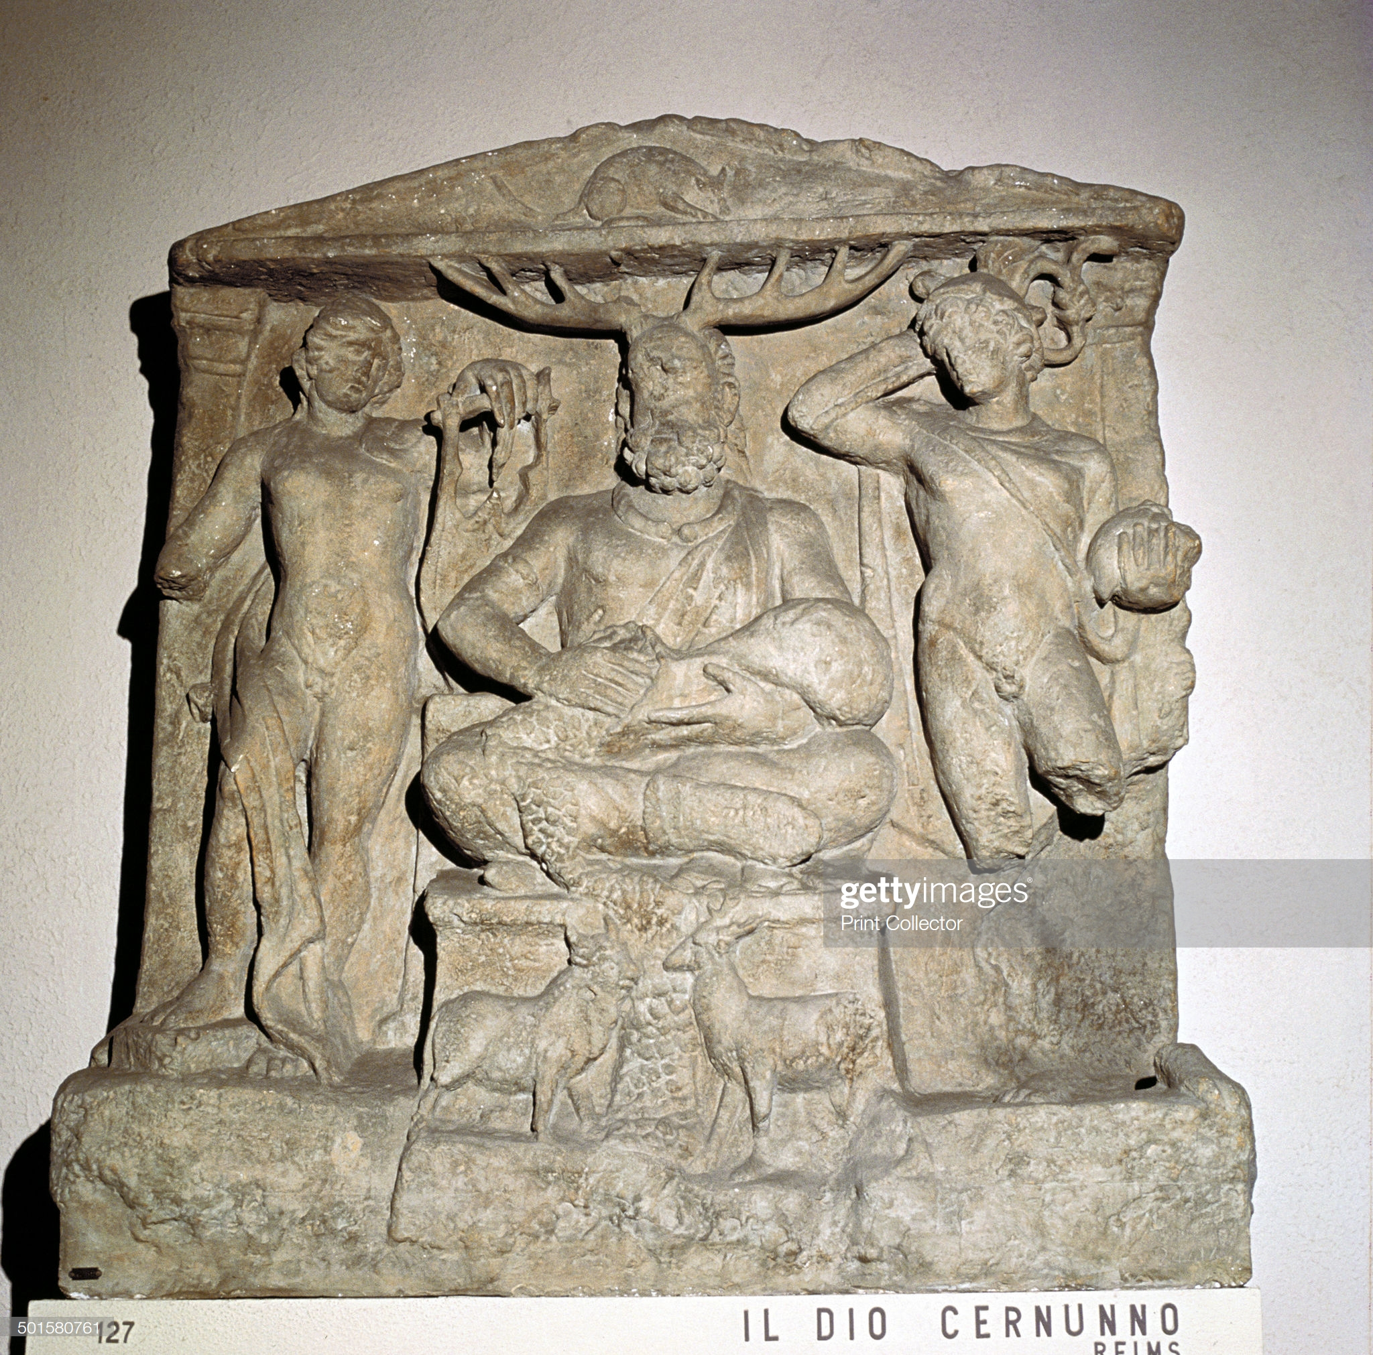
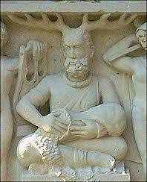
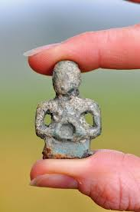
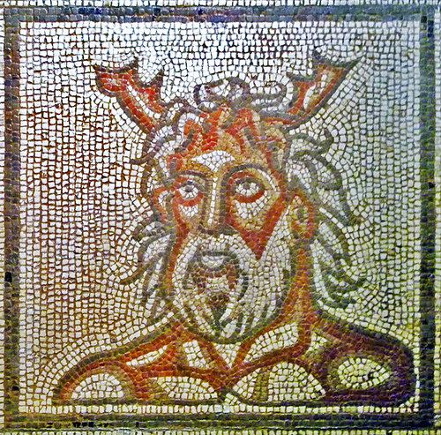
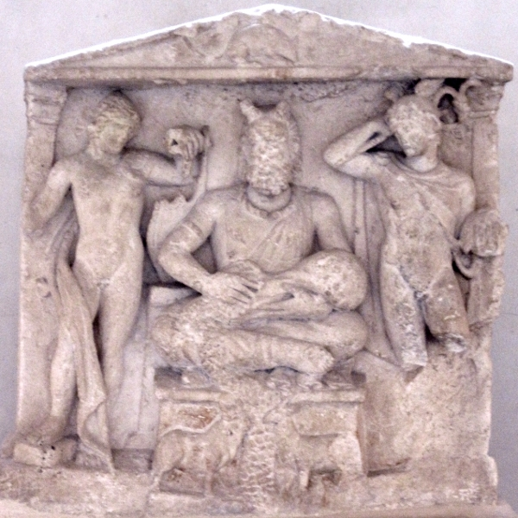
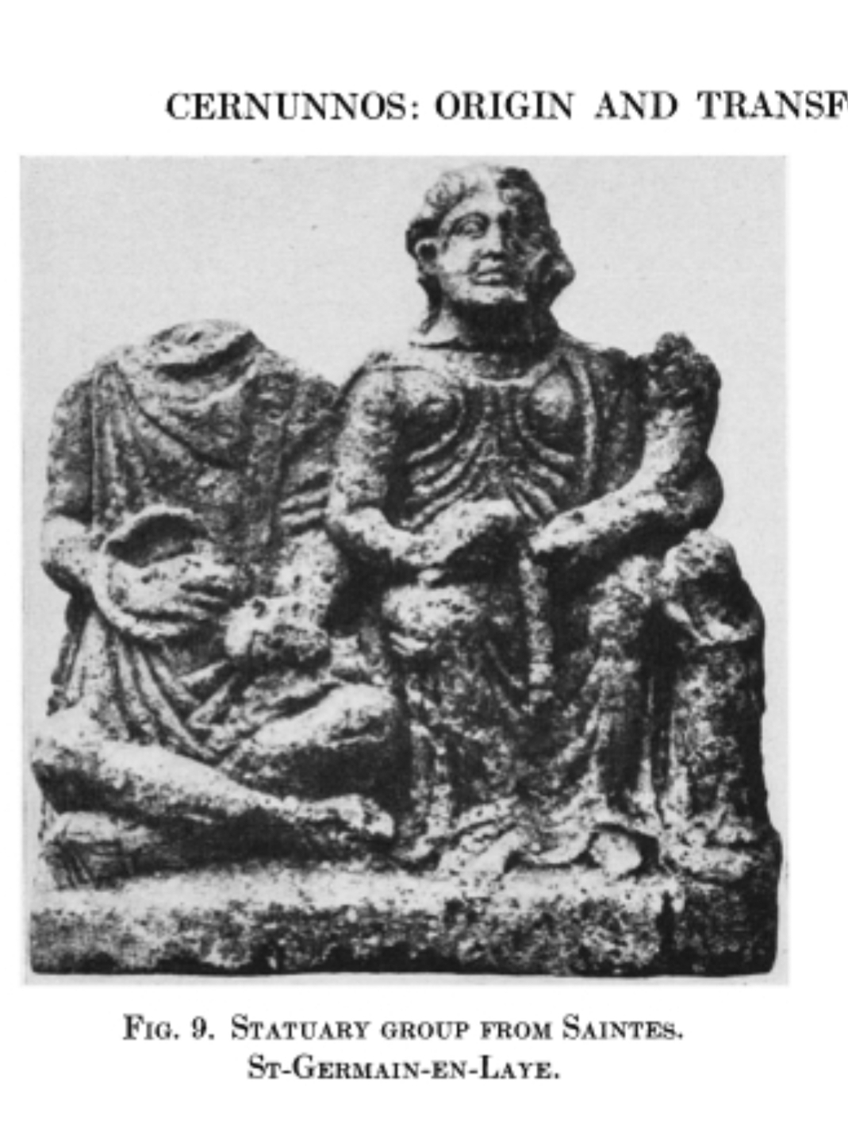
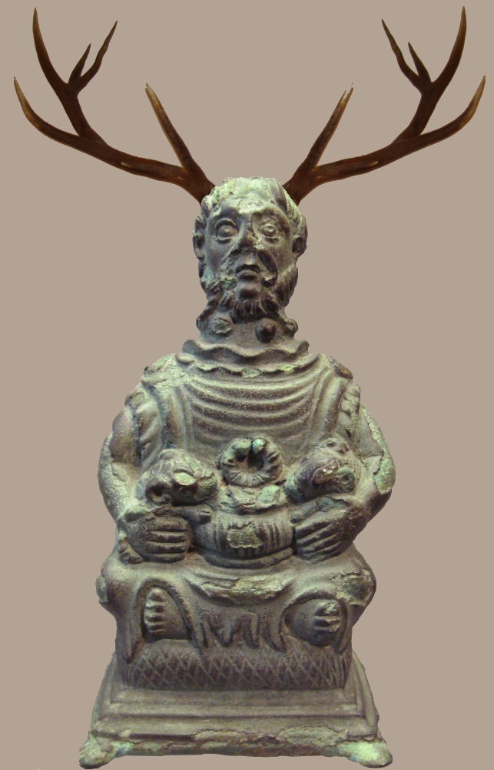
Romano-Celtic images of Cernunnos

Slide 11
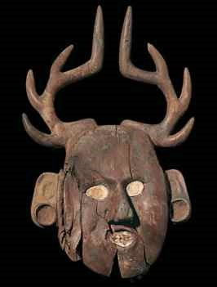
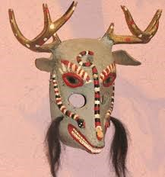
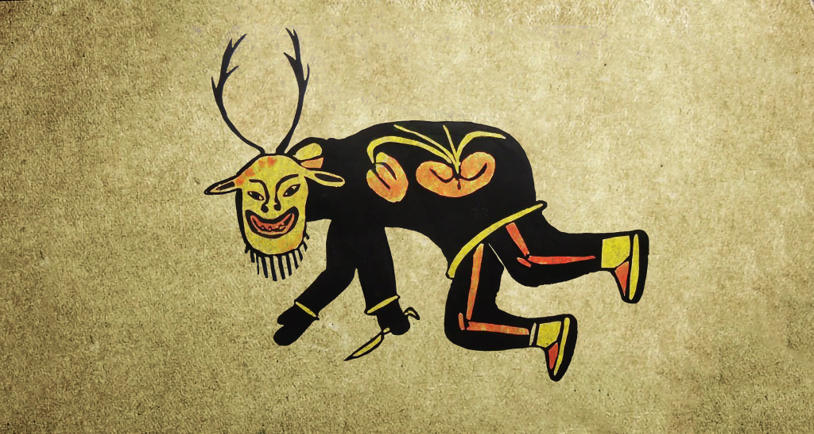
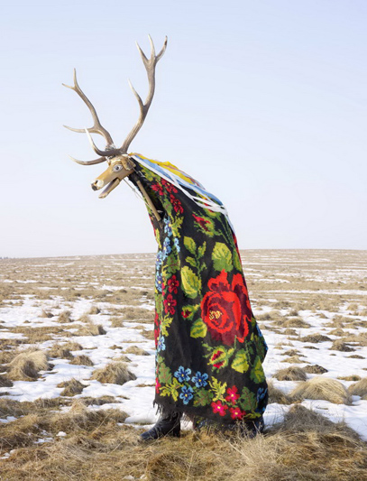
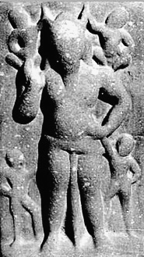
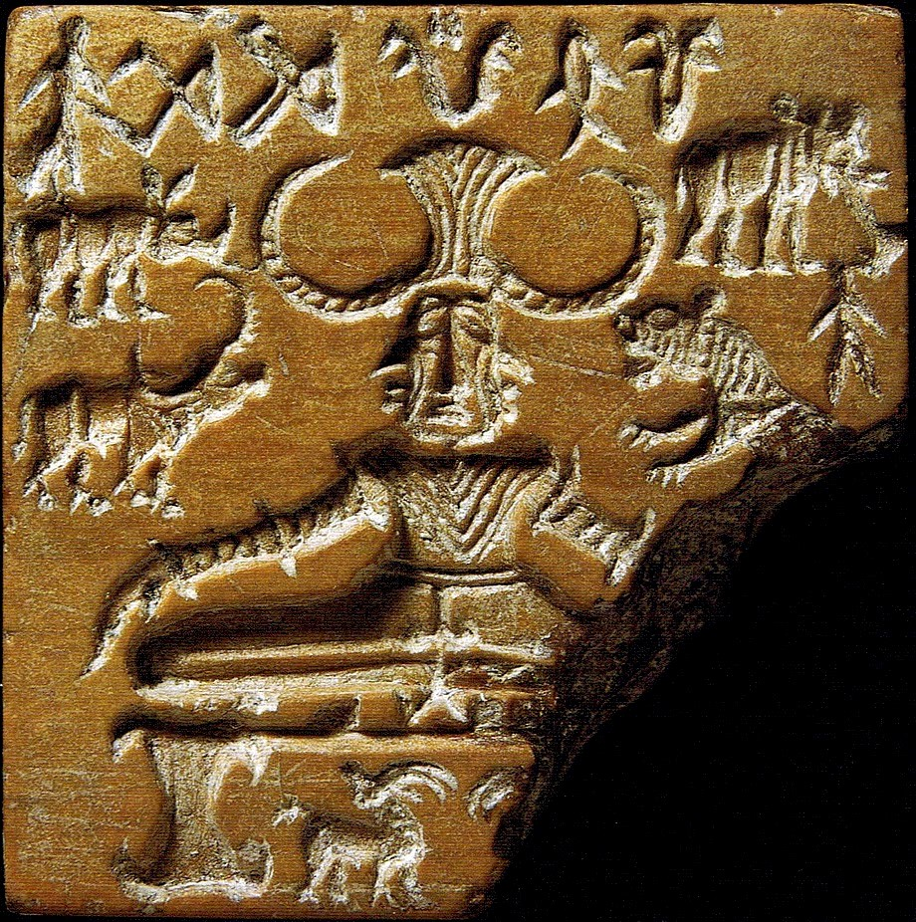
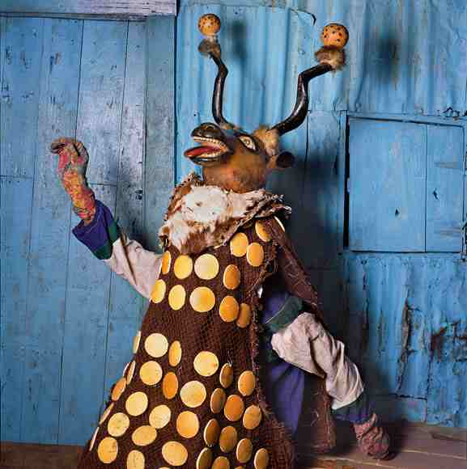
Horned Lord Worldwide
Okalahoma 1200
Inuit, 1970
Romania
Yaqui, USA & Mexico
Nepal
Japan
India
Africa: Sierra Leone, Burka Fiso

Slide 12
The missing link…. Folkplays!
Dorset ‘Ooser
Frontlet, Star Carr, England
Abbots Bromley Horn Dance, Staffordshire, England

Slide 13
Hooded Animal Traditions of the British Isles

Slide 14
Hooded Animals Worldwide

Slide 15
Resources:
Common Magick, origins and practices of British Folk Magick
by A.C. Fisher Aldag (Llewellyn Worldwide)
Witches & Pagans Magazine -- #38 The Peoples’ Magic, #39 Shamanism
Jason Mankey’s The Horned God of the Witches (Llewellyn)
A.C.’s website: acefisheraldag.com
Facebook Page: British Isles Folkloric Tradition

