Slide 1
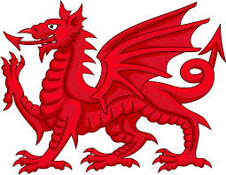
British Isles Folk Magick Traditions
A.C. Fisher-Aldag

Slide 2
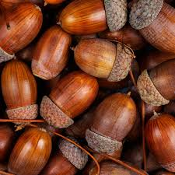
Sympathetic Magick
Used by nearly all Magickal systems
Term comes from Sir James G. Frazer in The Golden Bough
Used in spells / workings / rituals
“Like attracts like” (or like repels like)
Uses symbolism. Items represent a desired condition
Folk Magick uses common objects found in Nature
=

Slide 3
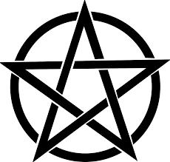
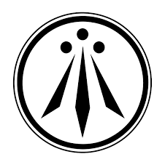
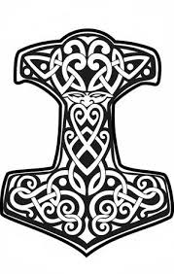
What are the folklore traditions of the British Isles?
What it is NOT: Wicca, Asatru, Druidry, nor Ceremonial Magic
While sharing some aspects, many things are done differently
Many of our customs can be incorporated into other praxes
Wicca – Gerald Gardner used some British Folk Magick beliefs & practices as a basis
Druidry – Traditions historically practiced by aristocrats and scholars of the British Isles
Asatru – Traditions of the Germanic and Scandinavian tribes, often overlap given the interactions between European tribes

Slide 4
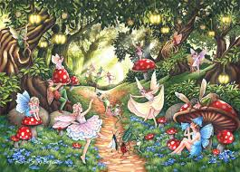
What it IS:
Folklore handed down through generations by word of mouth, & experiences.
Magick – To create change within surroundings or one’s self
Witchcraft – The practice of using magic, generally without any particular spirituality nor religion
Nature Spirituality / Earth Religion – Reverence for Nature, Belief in Entities, Ethical considerations
“Low” Magick – Close to Earth, experiential, vs. use of literature
Performed by the common people – farmers, craftspeople, homemakers
Common People – Common Magick

Slide 5
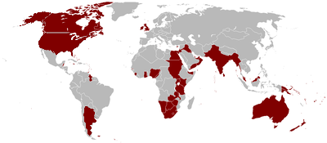
Where is/was it practiced?
British Isles – including England, Cornwall, Ireland, the Isle of Man, Scotland, Wales/Cymru, and Brittany (northern France)
Places where the people settled – places in which Britain was a dominant power, including much of the former British Empire especially in the USA & Australia
No ethnicity or place of origin restrictions!

Slide 6
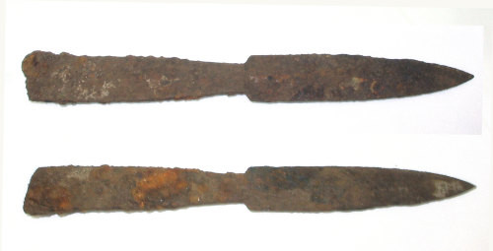
Example of a Common Tool
Iron Spike
In the old days a mining spike, iron pin, or weapon was used for Magick. After industrialization, railroad spikes were often used.
Also commonly used in Hoodoo & Conjure traditions.
Iron repels ethereal beings, represents strength, and is used to protect rooms, buildings, Magickal spaces - generally by being driven into the ground.
Can be found in Occult Stores, or discarded beside Railway tracks
Don’t clean if it rusts!
Pictured: Postmedieval iron spearhead or spike found in Northhamptonshire

Slide 7
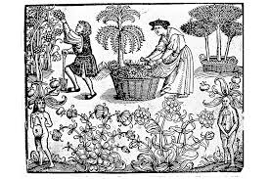
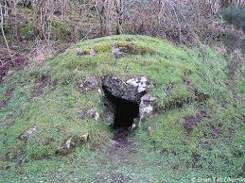
Concepts shared by most Magick systems
Active Magick – Manifesting change to the outside world
External – operates on the material world
Working – rite, spell; Ritual – longer rite
Passive Magick – Manifesting change to one’s self or consciousness
Internal – operates within the Self
Attunement – align, be in harmony with beings, self, world
Journey, Astral travel
Divination – Knowledge
Celebration - may include any and all of the above!

Slide 8
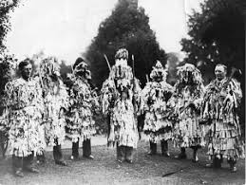
Folkplays and their role
Ritual drama, theater, skit, folk dance, Mummers’ play
Done to bring a situation about through sympathetic Magick by acting out a drama
May have lost meaning over time, done only with the intention of carrying on a tradition or to encourage tourism - yet still creates a Magickal effect
Can Avatar ENTITIES
Entities: Deities, spirits, heroes, ancestors, Magickal beings
Avatar: To take on characteristics of an entity, let them work through you.
Done during rituals, especially ritual theater / folkplay
Term comes from Hindu. AKA Aspect, Drawing Down the Moon (In Wicca)
Similar to the Afro-Caribbean practice of spirit possession
How-to in Common Magick or on my website

Slide 9
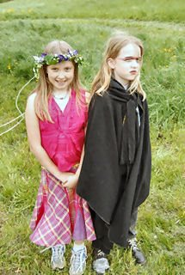
Example of a Folkplay
Beltane May Branch – A branch of flowering tree (such as hawthorn or apple) decorated with flower talismans
Folk Deities
May King / Queen, Avatar representing Spring.
Yr Angau / L’Ankou, Avatar representing Death.

Slide 10
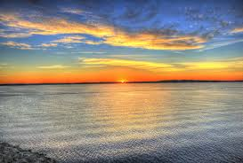
Liminality:
Liminal Times, Places:
Betwixt & Between, Ending & Beginning, Both & Neither
Change
Have their own qualities
Strong Magical energies
Liminal Times: new & full moons; Solstices, Equinoxes, cross-quarters; dawn, dusk, midday, midnight (astronomic events); Rites of Passage
Liminal Places: Outdoors – Bridge, cliff, tunnel, fairy forts /tombs, graveyards, crossroads, stone circle, beach. Indoors – Attic, basement, chimney, windowsill, threshold, hearth
Powerful when combined – crossroads at midnight, beach at dawn.

Slide 11
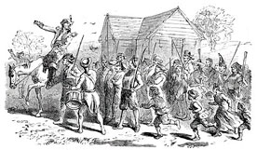
Beating the Bounds
Authentically older tradition, still practiced in Britain & USA
Somewhat secularized or Christianized
Done around Spring Equinox
Used to Remember boundary markers, but also for protection.
HOW: Hit things w/ staff, bury eggs at corners, speak words of power.

Slide 12
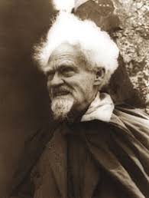
Other Praxes – Similar & Different
Wicca: Gerald B. Gardner used some actual British Folk Magick & Witchcraft for Wicca.
From Southeastern / Central England – Bricket Woods, New Forest
Praxes borrowed from us:
Spells, rituals, workings
Tying knots for witches’ ladder
Potions
Using sympathetic magick
Dancing to raise energy
Ritual dramas / folkplays like “Descent of the Goddess”
Divination, Meditation
Stuff Wiccans Do Differently:
Initiations / Lineage
Degree System / Heirarchy
Casting Circle
Calling Quarters
Using Eastern mysticism & Ceremonial Magick
Many different Tools
Gerald B. Gardner

Slide 13
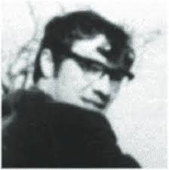
Other Praxes – Similar & Different
British Traditional Witchcraft: Robert Cochrane used some actual British Folk Magick & Witchcraft for his craft.
From Southwestern England & Cornwall
Praxes borrowed from US:
Spells, rituals, workings
Using sympathetic magick
Folk Deities - Bucca
Close to the Earth
Drawing power from Nature
Attunement with Nature
Familiar Spirits
Stuff Brit Trad W’craft Does Differently:
Initiations
Hierarchy
Using Ceremonial Magic
Drawing a Compass
Many different Tools
- Stang; Doth & Rig
Image Credit: Museum of Witchcraft & Magic
One of the few known photographs of Robert Cochrane

Slide 14
Unique British Folk Magic Praxes
No:
Initiations, Degrees, Hierarchy, Lineage
Ritual Circle as a safe space, liminal space, or to contain energy
Great Goddess / Father God
Elements /Watchtowers /“calling quarters” /Archangels /4 Directions
Few altars
Different:
Methods of summoning power & using Magick (like folkplays)
Entities / Magickal helpers are different from Wicca
Protecting ourselves, Magickal defense, ritual tools

Slide 15
What British Isles Folk Magic does:
Elders train younger people; learning through experience
Rites of Passage
Entities: Deities, spirits, ancestors, Fae / fairies, heroes
Folk entities – Spring, Death; Also Bucca (Cernunnos) Mawb / Madron
Entities can be asked to help, or Avatared
Animism
Witchcraft might not believe in entities at all
Self-protection during rites
Ethical system using Honor
FUN!!!

Slide 16
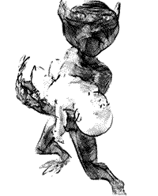
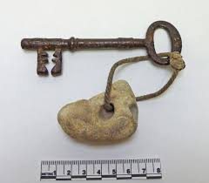
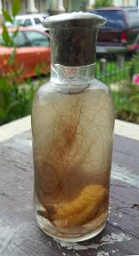
Magickal Protection:
Protection From What?
Harmful entities, attracted to Magick
Curses / hexes
Baleful emotions – anger, jealousy
Illnesses, normal human problems
How:
Appeal to entities
Talismans / amulets / sigils
Words of power
Witches’ Bottle
Talisman, Museum of Witchcraft & Magic

Slide 17
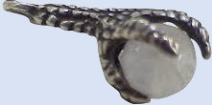
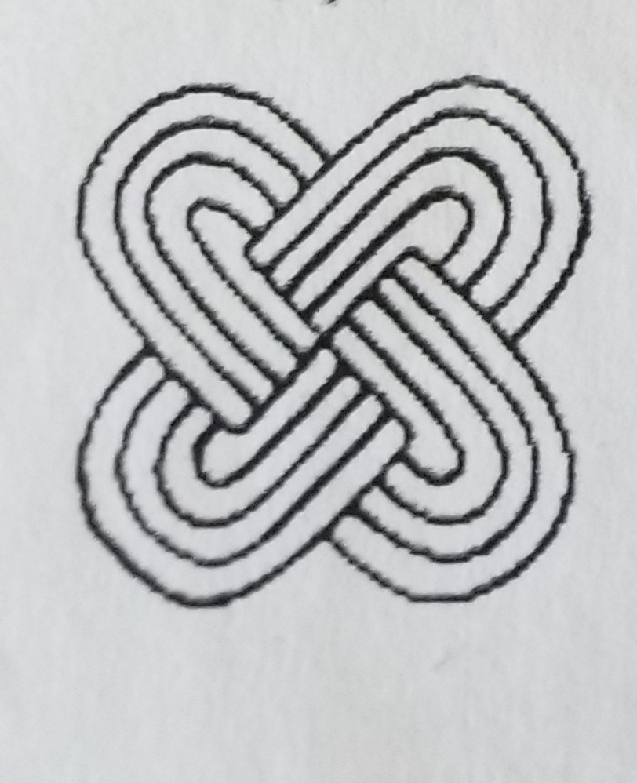
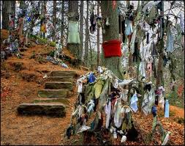
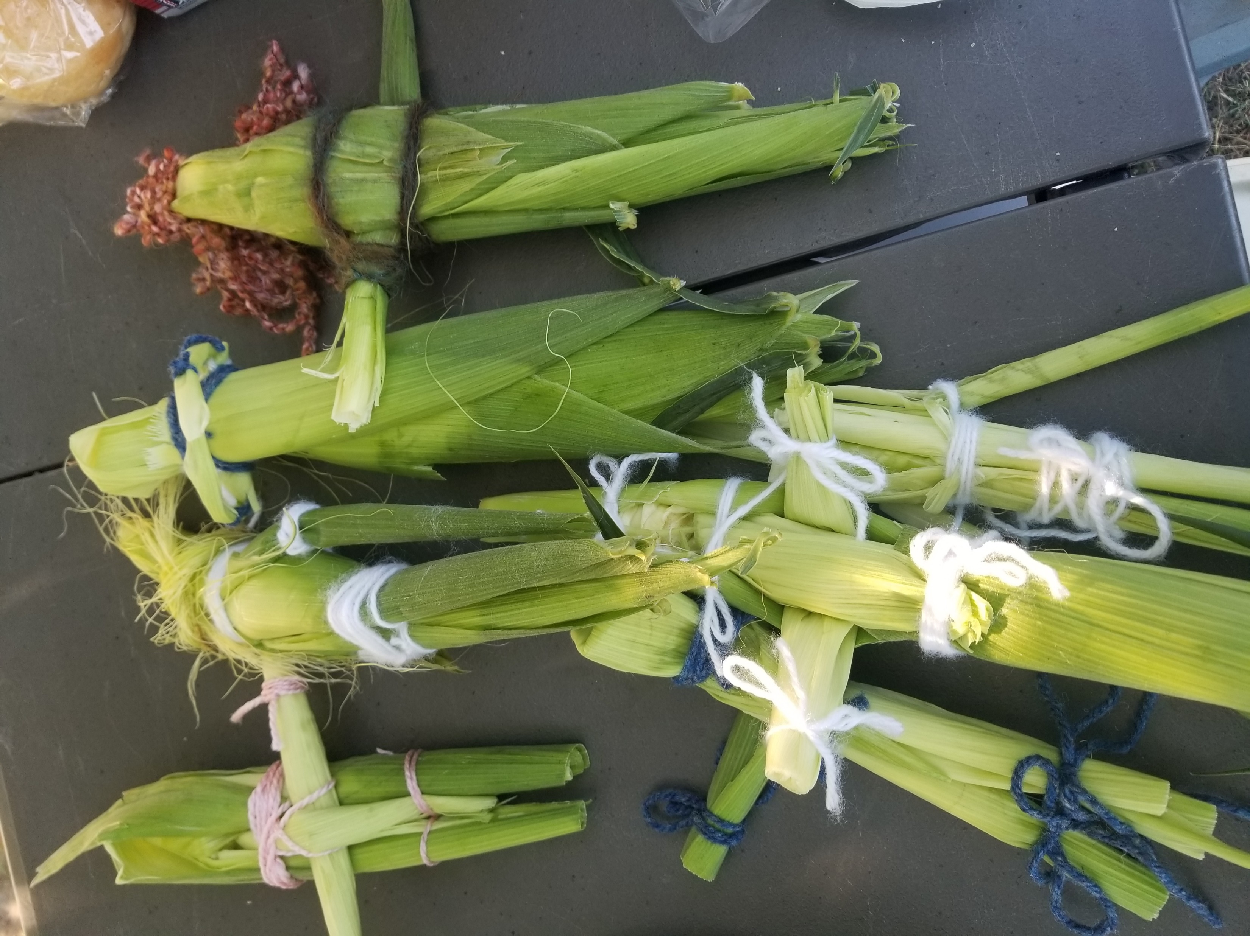
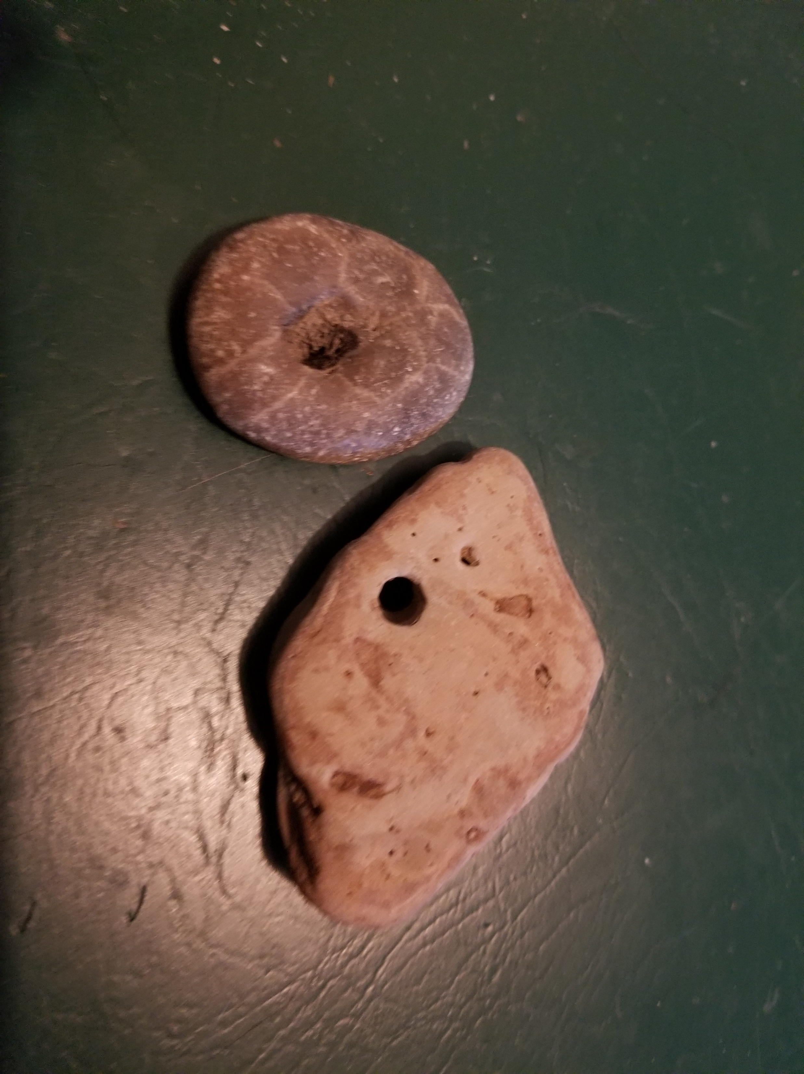
Talismans / Amulets
Objects used to store power
Power is raised through ritual, spell or working OR
The object has an intrinsic quality (like iron)
Can use CONTAGION magick – transfers power through touch
Can use SYMPATHETIC magick – like attracts like
Apotropaic – wards off harmful energies or beings

Slide 18
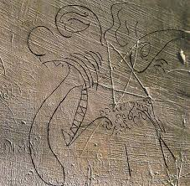
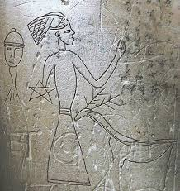
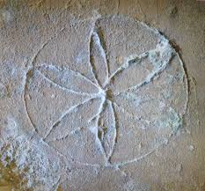
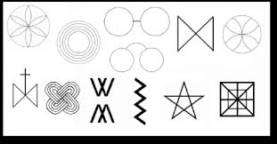
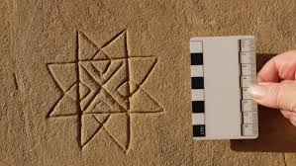
Protective Sigils:
Hexfoils, witches’ marks, sigils witches’ runes
Found throughout Britain – government survey uncovered hundreds!
Genuinely older custom, used right up to the present day
Used by Pagans & Christians
Symbols include Daisy Wheel, Pentagram, spectacles, VM, maze, corn king, deer, ships, others
From the book Medieval Graffiti
by Matthew Champion

Slide 19
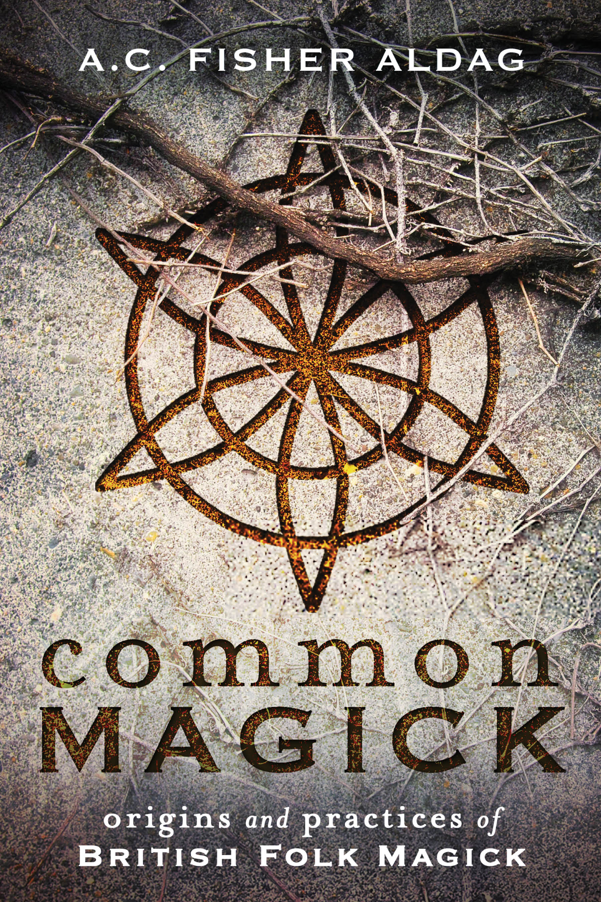
For More Information:
Common Magick: Origins and Practices of British Folk Magick (Llewellyn)
Witches & Pagans Magazine, Issues #38 & #39 (BBI Media)
British Isles Folkloric Tradition on Facebook
My website: acfisheraldag.net
FREE articles, pictures, information
Buy my books and articles there
Fiction books on Amazon (from Ravenswood Publications)
Cambria, Indiana
This Bright Land o’ Blessing
Come to events! Festivals, conventions, Pagan Pride Days

Slide 20
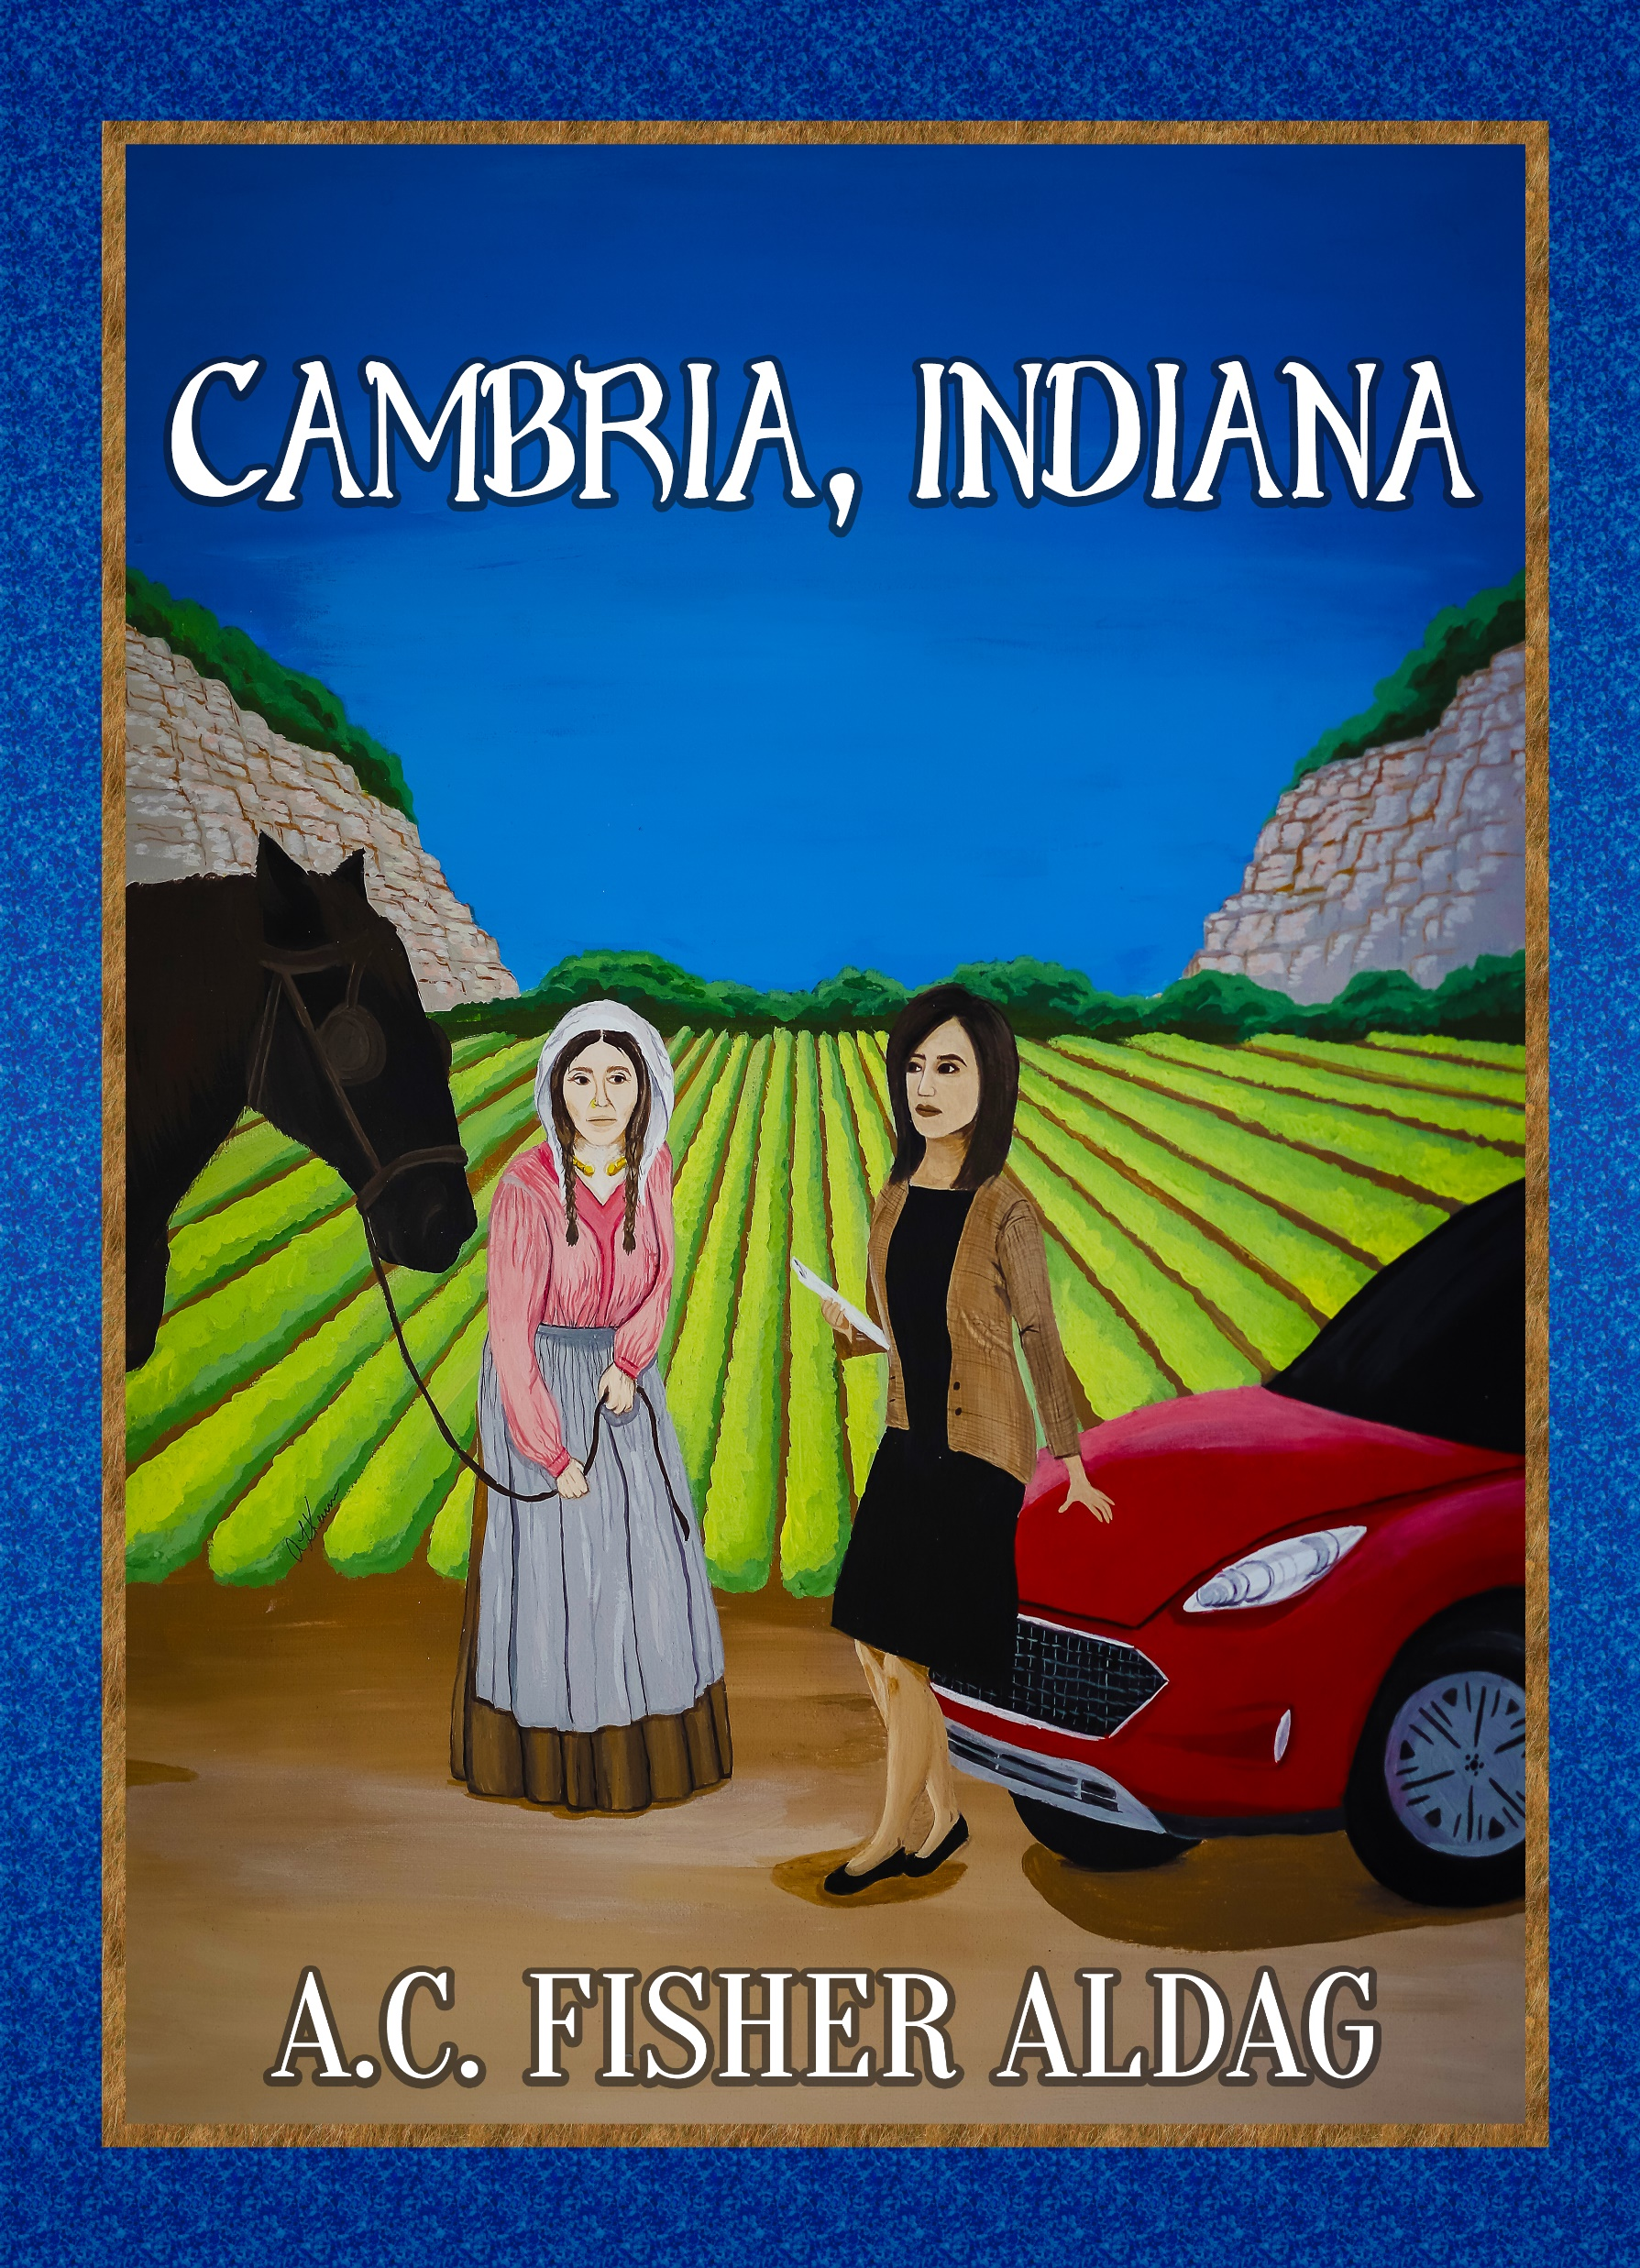
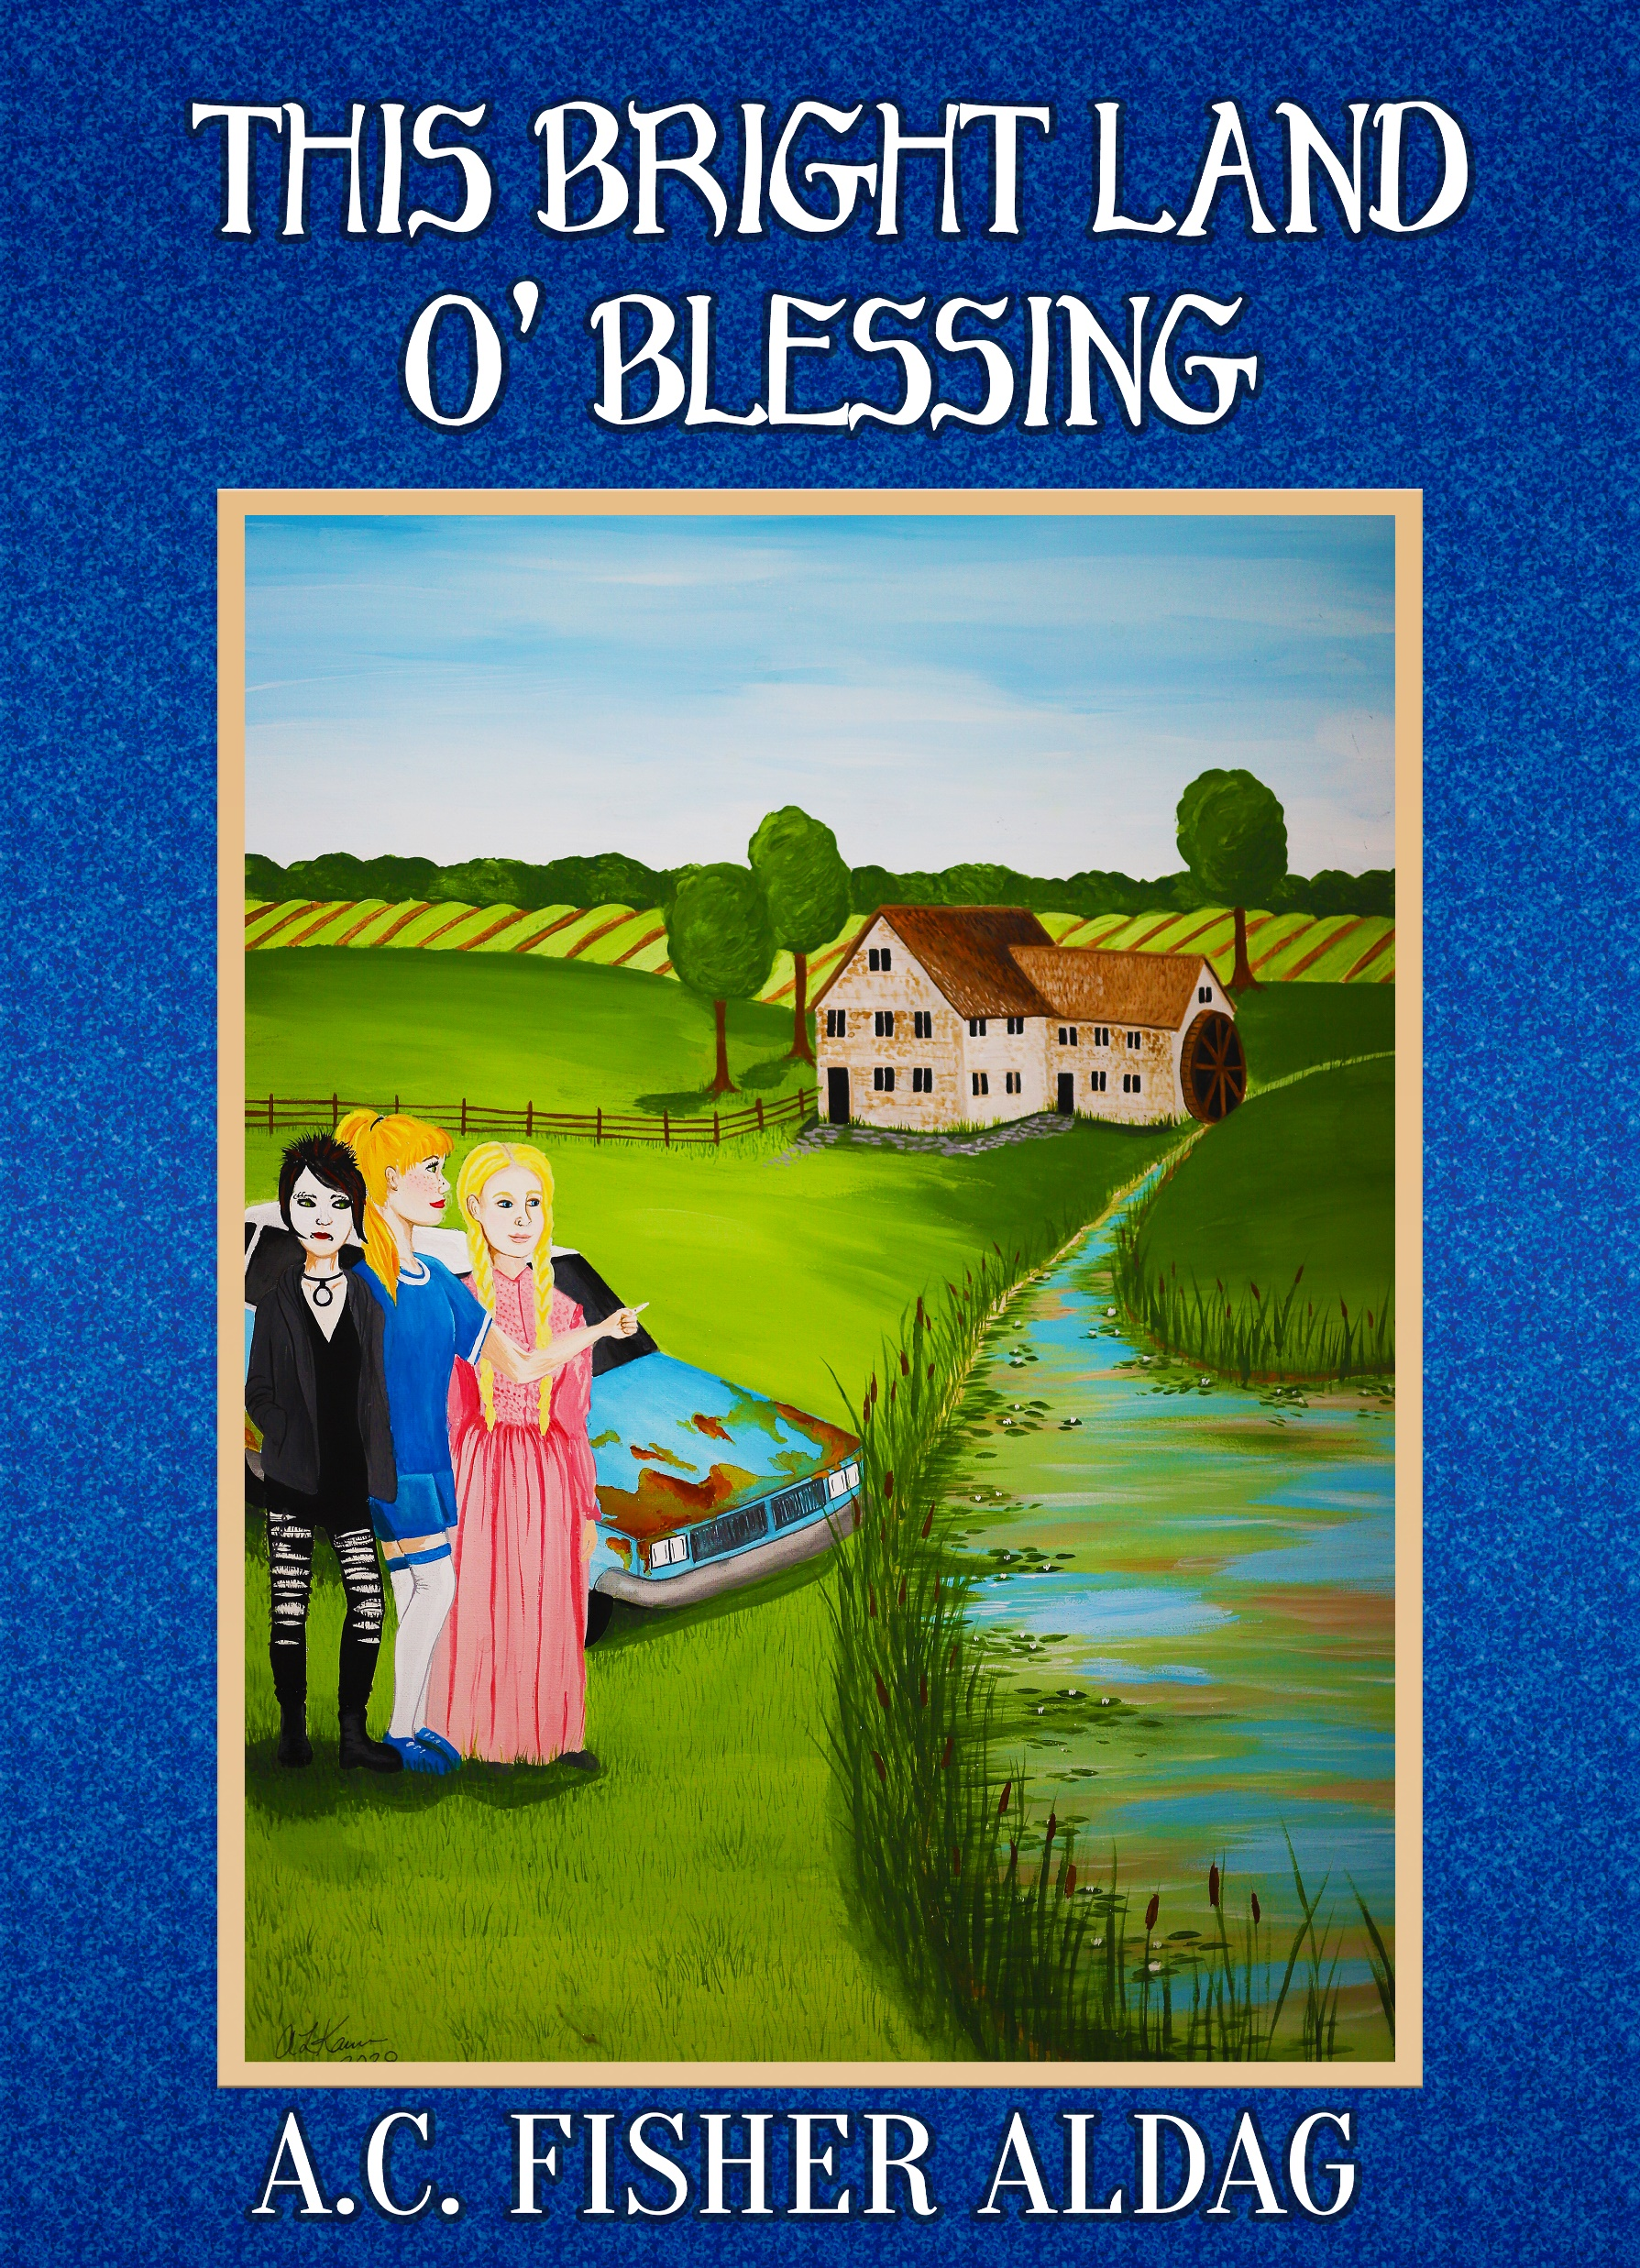
A.C. Fisher Aldag -- VENDING
Common Magick: Origins and Practices of British Folk Magick (Llewellyn)
For autographed copies, please email acefisheraldag@gmail.com
Fiction books on Amazon (Ravenswood Publications)
Cambria, Indiana
This Bright Land o’ Blessing
Witches & Pagans Magazine #38 & #39 (BBI Media)
British Isles Folkloric Tradition on Facebook
www.acfisheraldag.net FREE articles & more info!

Slide 21
common Magick origins and practices of British Folk Magick
Explore the magick!
A showcase of Spells, Lore, and the Origins of Magickal Practices of the British Isles.
This book reveals why folk magick works, and shares deep knowledge of magickal timing, sigils, crafts, tools, and more. Discover what it is like to work with nature spirits, fairies, deities and energy beings, as well as herbs, crystals, divination, as well as the historic practices of folkplays and magickal dances.
Available from Llewellyn Worldwide
https://www.llewellyn.com/product.php?ean=9780738763132

Slide 22
Cambria, Indiana
Pagan Fiction by A.C. Fisher Aldag, author of Common Magick
The Celtic tribes living in present-day Indiana have kept the ancient ways of their forebears, including the use of magic. When modern society encroaches, the chieftain and priestess Lady Cairne Auldwedd uses her supernatural powers to summon help from her goddess. Cultural anthropologist Dr. Joyce DelaFemina soon arrives in Cambria to study the tribe. She and Lady Cairne become friends, to the dismay of her Cymric tribesfolk. While assisting the Celts, Joyce becomes embroiled in a frightening blood feud, falls in love with the chieftain’s court bard, and discovers her own talent for magic. Cambria, Indiana has the excitement of a sword-fight at the hardware store, the romance of a Celtic fairy tale, and the beauty of a bard-sung legend.
Available from Ravenswood Publishing and on Amazon.
https://www.amazon.com/Cambria-Indiana-C-Fisher-Aldag/dp/B086LDM79Z

